Slide 1

Vehicle Fuel Analysis
A data backed analysis of fuel economy across an array of manufacturers and vehicle types.
by
Frederic Randall
Photo by Juan Fernandez on Unsplash

Slide 2
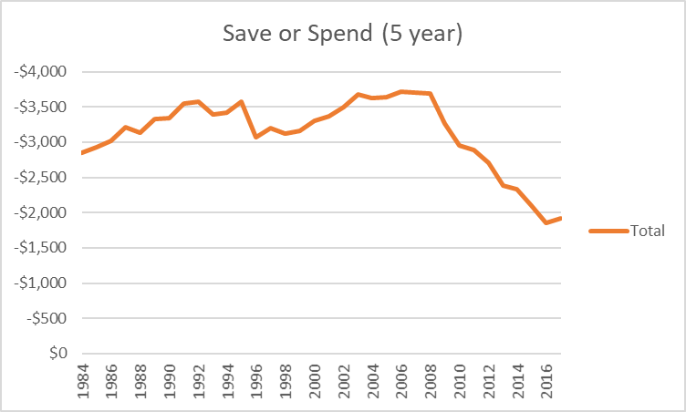
Overview
For the purposes of online consumer products review, I have conducted an indepth study from available data to help review site editors and consumers make informed purchasing decisions.
In the course of the research I have:
Created a user-friendly dashboard that allows the user to observe a number of different fuel economy statistics.
Conducted statistical analyses concerning fuel economy ratings and long-term savings.
Developed recommendations for consumers looking to gain the most value from the vehicle purchases.
Many manufacturers have addressed consumer demand for vehicles that provide customers with more long-term savings in the last decade.
Photo by Juan Fernandez on Unsplash

Slide 3

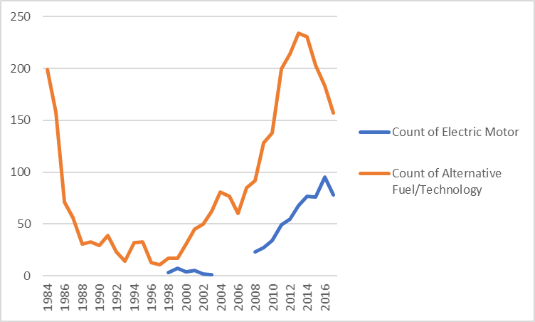
Objectives
Assessing Consumer Interests.
While fuel economy and its effects on short-term and long-term costs is something all customers should know, it likely isn’t the first factor that consumers will consider.
Most consumers already have fair idea of the type of car and specific vehicles that they are interested in or willing to pay for.
Communicating Relevant Findings
The factors that will best guide consumers to an informed decision are the immediate, short-term, and long-term fuel costs that will afftect them as owners.
Some but not all consumers will be influenced by Fuel Economy Ratings and CO2 Emissions.
Environmental concerns and savings intersect in the rise in demand for alternative fuel technologies and electric motors.
Photo by John Schnobrich on Unsplash

Slide 4
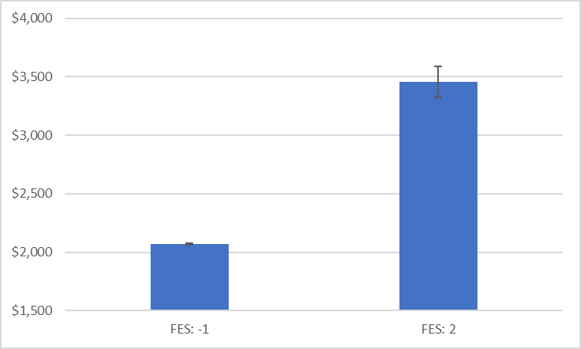
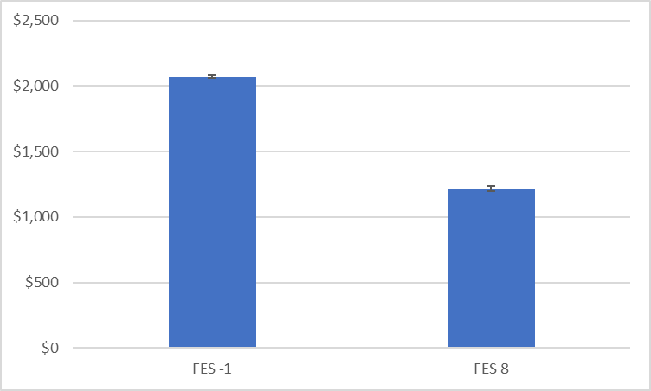
Do Fuel Economy Scores Reflect Annual Fuel Costs?
Not Necessarily
Fuel Economy Scores take a wide variety of variables into consideration, so a higher score doesn’t necessarily mean lower annual costs.
After several statistical analyses I found that only vehicles with notably high fuel economy scores showed considerable annual savings.
Recommendation
Unless they can afford vehicles with a score of 5 or higher, customers concerned with annual fuel costs should consider other variables before Fuel Economy Score.
Photo by John Schnobrich on Unsplash

Slide 5

Comparing Annual Fuel Costs
While unable to trace a reliable correlation between Fuel Economy Scores and annual costs, there is ample evidence of distinct differences in Annual Fuel savings that vary between Class type.
Through statistical analysis we can say with confidence that means of Compact Cars and other classes of cars have a significant difference in means of Annual Fuel Cost.
Across 27 statistical analyses each class of car returns a significantly different mean of Annual Fuel Cost than the whole sample of vehicles
Photo by Tim Mossholder on Unsplash

Slide 6
A Closer Look At The Data
t-Test: Two-Sample Assuming Unequal Variances
 | Total Annual Fuel Cost | Fuel Cost 1500\
Mean | 2054.39745 | 1500
Variance | 510054.6544 | 0
Observations | 38113 | 38113
Hypothesized Mean Difference | 0
df | 38112
t Stat | 151.5477294
P(T<=t) one-tail | 0
t Critical one-tail | 1.644893609
P(T<=t) two-tail | 0
t Critical two-tail | 1.960026231
standard error sample | 3.658236596
margin of error | 7.170239689
c.i. lower | 2047.22721
c.i. upper | 2061.567689
Reject the null that the sample mean is equal to the hypothesized mean of 1500
The sample mean is significantly different at p < .05
With 95% confidence the population mean is between 2047.23 and 2061.56
By running a one sample t-test we get a sense of how our sample of Total Annual Fuels costs might compare with the total population mean.
We can proceed with confidence that the actual population mean is not likely to vary largely from our sample mean.
Photo by Tim Mossholder on Unsplash

Slide 7

Reviewing Our Methods
To Review
We have used A/A testing to verify the validity of our sample data.
A/B testing was used to show significant difference in means between fuel costs in a variety of car classes.
Single Sample t-tests give us p values and confidence interval by which to assess the validity of our data.
Results
We found that we cannot confidently assess savings from Fuel Economy Scores.
We found that we can trust the difference in means of Annual Fuel Costs in varying classes of cars
We determined that the savings variables that we measured can be trusted.
Photo by Helloquence on Unsplash

Slide 8
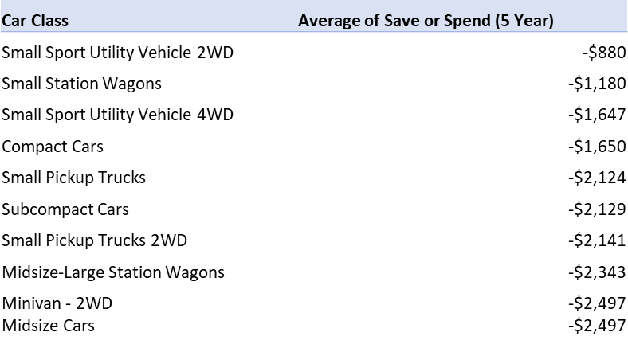
Recommendations By Class
Class | Average of Total Annual Fuel Cost
Small Station Wagons | $1,597
Small Sport Utility Vehicle 2WD | $1,661
Compact Cars | $1,706
Small Sport Utility Vehicle 4WD | $1,762
Small Pickup Trucks | $1,775
Subcompact Cars | $1,793
Midsize-Large Station Wagons | $1,819
Small Pickup Trucks 2WD | $1,836
Midsize Cars | $1,896
Midsize Station Wagons | $1,915
After verifying the validity of our sample data, we can identify the top ten classes of car for customers that value long-term and short-term savings.
Photo by Helloquence on Unsplash

Slide 9


Recommendations By Make
Make | Average of Total Annual Fuel Cost
Tesla | $699
CODA Automotive | $900
BYD | $1,013
smart | $1,027
Azure Dynamics | $1,050
Daihatsu | $1,229
Scion | $1,326
Geo | $1,336
Grumman Olson | $1,363
Fiat | $1,364
Make | Average of Save or Spend (5 Year)
Tesla | $3,256
CODA Automotive | $2,250
BYD | $1,688
smart | $1,617
Azure Dynamics | $1,500
Daihatsu | $603
Scion | $119
Geo | $70
Grumman Olson | -$63
Fiat | -$69
For customers who are less concerned about the potential costs and savings of particular classes of cars, we can compile a list of the most cost efficient makes of vehicles.
Photo by Matt Palmer on Unsplash

Slide 10
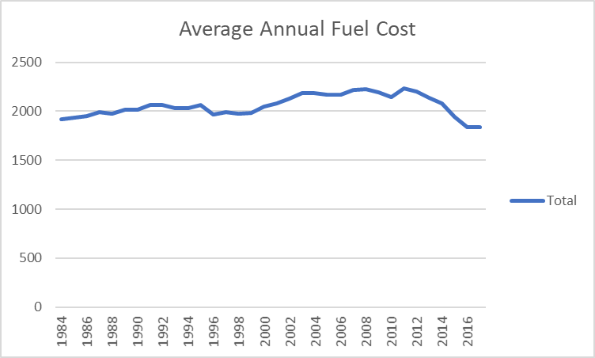
About Annual Fuel Costs
While long term fuel costs have dropped significantly since 1984, the average annual fuel cost for most vehicles remains relatively unchanged.
Compare this 5% drop in annual fuel costs with the 33% drop in 5 Year Save or Spend that we saw earlier in the presentation.
Photo by Matt Palmer on Unsplash

Slide 11

Interactive Dashboard
Photo by Dawid Zawiła on Unsplash

Slide 12
Interactive Dashboard
Photo by Dawid Zawiła on Unsplash

Slide 13

In Conclusion
In consideration with my findings, I recommend that consumers concerned with fuel economy target:
Electric Motors
Emerging Alternative Fuel Technology
Smaller Vehicles
2WD Vehicles
Photo by Holden Baxter on Unsplash

